Slide 1

Time and Frequency
Calibration of
Stopwatches
Engineer Liz Catherine Hernández Forero
Engineer Eduin Culma Caviedes

Slide 2

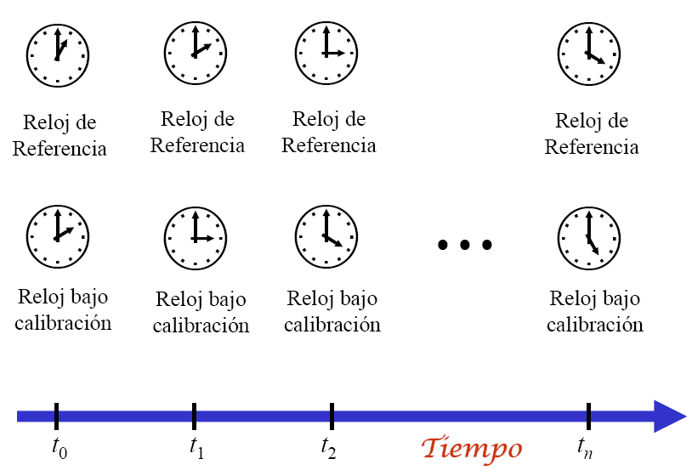
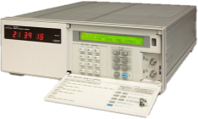
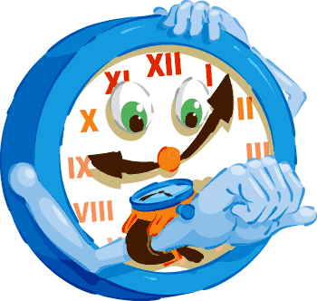
DIRECT TIME MEASUREMENT
Reference Clock
Reference Clock
Reference Clock
Reference Clock
Clock
under calibration
Clock
under calibration
Clock
under calibration
Clock
under calibration
Time

Slide 3
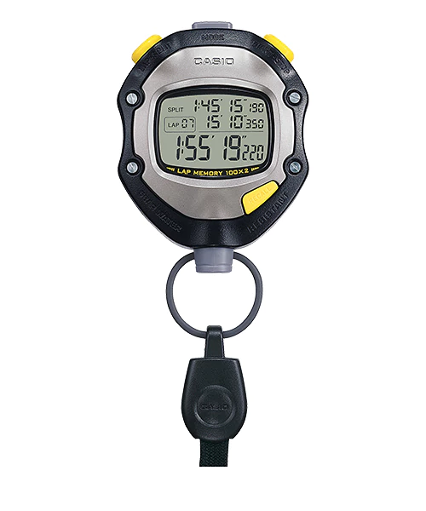
INDIRECT FREQUENCY MEASUREMENT
Metal Shielding
Conductive surface
Amplifier control
Frequency counter
Typical signal
Amplifier stage
Oscilloscope

Slide 4
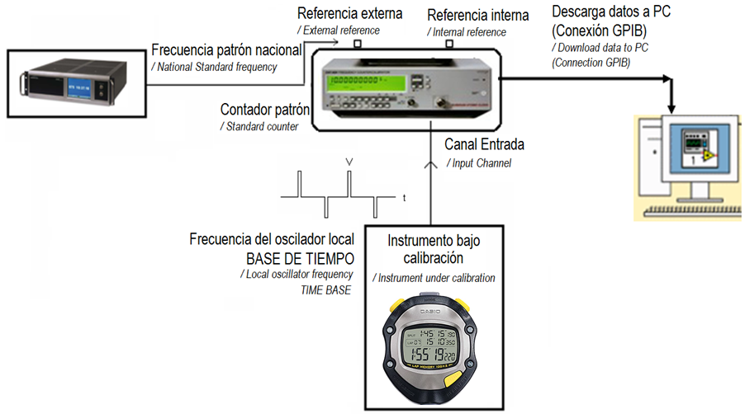

INDIRECT FREQUENCY MEASUREMENT

Slide 5
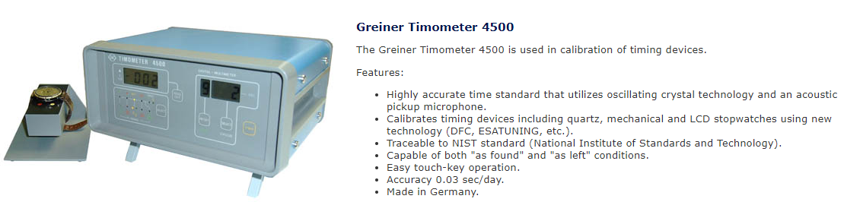
INDIRECT FREQUENCY MEASUREMENT
http://www.jewelerssupplies.com/product7141.html

Slide 6
DIRECT TIME MEASUREMENT
Reference Clock
Reference Clock
Reference Clock
Reference Clock
Clock
under calibration
Clock
under calibration
Clock
under calibration
Clock
under calibration
Time

Slide 7

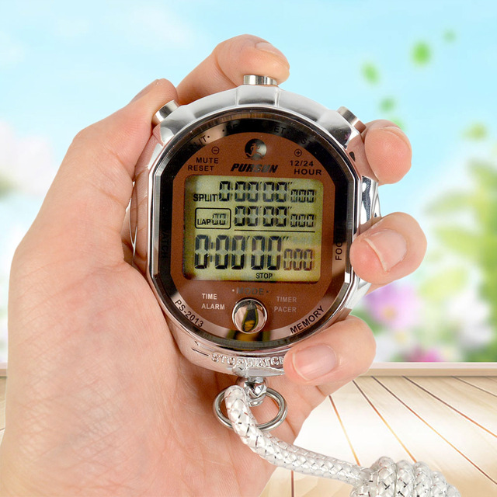
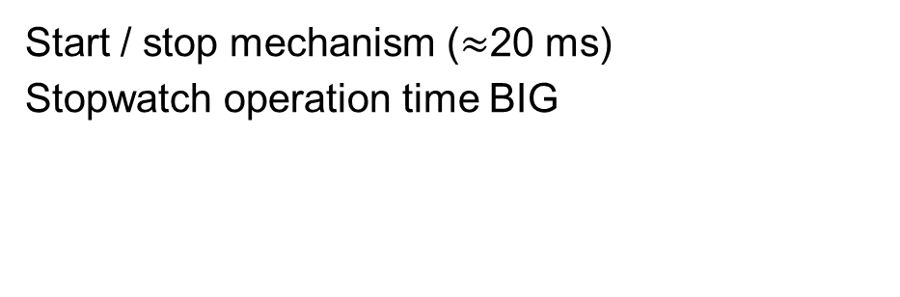
Metrological confirmation
Start / stop mechanism ($≈$20 ms)
Stopwatch operation time BIG
Stopwatch
DIFFERENCES OF
ACCUMULATED TIME
OF MEASURING
Small
Start / stop
versus

Slide 8
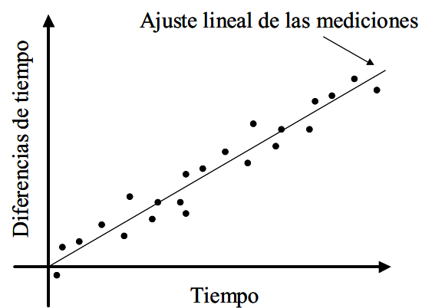
Linear adjustment of measurements
Metrological confirmation
Time differences
Stopwatch
Time
DIFFERENCES OF
ACCUMULATED TIME
OF MEASURING
Small
Start / stop
versus

Slide 9
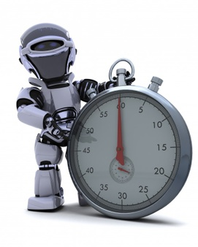
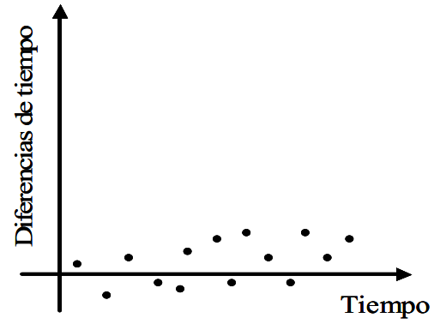

Linear adjustment of measurements
Time differences
Stopwatch
Time
Time differences
Time

Slide 10
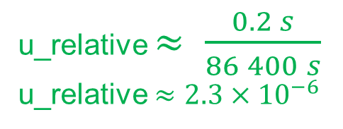

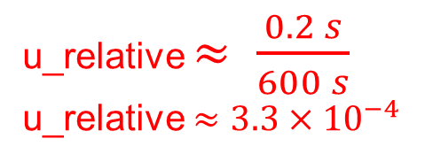
Linear adjustment of measurements
u_operator $≈$ 0.2 s
T = 24 h
T = 86 400 s
Time differences
u_relative $≈ \frac{0.2 s}{86 400 s}$
u_relative $≈2.3×{10}^{−6}$
Time
T = 10 min
T = 600 s
Time differences
u_relative $≈ \frac{0.2 s}{600 s}$
u_relative $≈3.3×{10}^{−4}$
Time

Slide 11

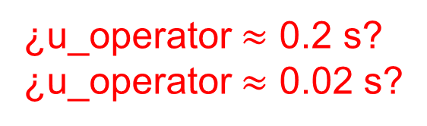
Repeatability and Reproducibility
¿u_operator $≈$ 0.2 s?
¿u_operator $≈$ 0.02 s?
Fuente: http://www.caletec.com/blog/tag/estudios-rr/

Slide 12

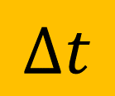

DIRECT TIME MEASUREMENT
Reference Clock
Reference Clock
Reference Clock
Reference Clock
$$∆t$$
Clock
under
Clock
under calibration
Clock
under calibration
Clock
under calibration
calibration
$$=\left\{{Clock}_{Ref}−{Clock}_{IBC}\right\}$$
$$τ$$
Time

Slide 13
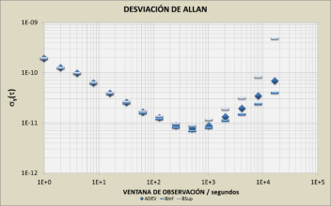
DIRECT TIME MEASUREMENT
ACCURACY
Frequency
Offset
STABILITY
t is the time measured by the standard.
t_{stopwatch} is the time measured by the instrument under calibration.
Fuente:
Introduction to Frequency Measurements (Generación y medición de frecuencia).
Francisco Jiménez, CENAM.
SIM TFMWG Workshop and Planning Meeting at CENAMEP
Panama City, Panama (January 27th through January 29th, 2015)
Allan Deviation
2 is the coverage factor k.

Slide 14
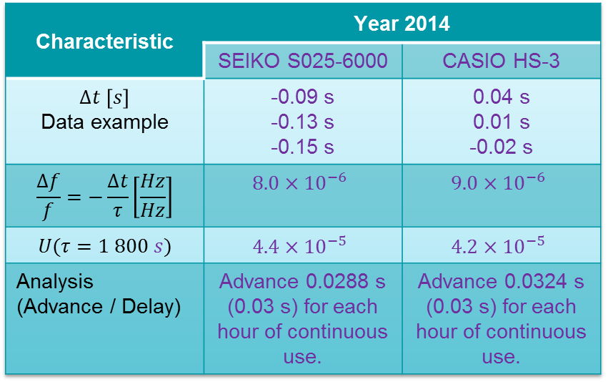
INDIRECT FREQUENCY MEASUREMENT
Characteristic | Year 2014
 | SEIKO S025-6000 | CASIO HS-3
$$∆t \left[s\right]$$ Data example | -0.09 s -0.13 s -0.15 s | 0.04 s 0.01 s -0.02 s
$$\frac{∆f}{f}=−\frac{∆t}{τ}\left[\frac{Hz}{Hz}\right]$$ | $$8.0×{10}^{−6}$$ | $$9.0×{10}^{−6}$$
$$U(τ=1 800 s)$$ | $$4.4×{10}^{−5}$$ | $$4.2×{10}^{−5}$$
Analysis (Advance / Delay) | Advance 0.0288 s (0.03 s) for each hour of continuous use. | Advance 0.0324 s (0.03 s) for each hour of continuous use.

Slide 15
INDIRECT FREQUENCY MEASUREMENT
Metal Shielding
Conductive surface
Amplifier control
Frequency counter
Typical signal
Amplifier stage
Oscilloscope

Slide 16
F_stopwatch = {f_quartz / (2^10)}
F_stopwatch = {f_quartz = 32 768 Hz / (1024)}
F_stopwatch = {f_quartz = 32.0 Hz}

Slide 17
INDIRECT FREQUENCY MEASUREMENT
ACCURACY
Average
Frequency
Offset
STABILITY
t is the time measured by the standard.
t_{stopwatch} is the time measured by the instrument under calibration.
Fuente:
Introduction to Frequency Measurements (Generación y medición de frecuencia).
Francisco Jiménez, CENAM.
SIM TFMWG Workshop and Planning Meeting at CENAMEP
Panama City, Panama (January 27th through January 29th, 2015)
Allan Deviation
2 is the coverage factor k.

Slide 18
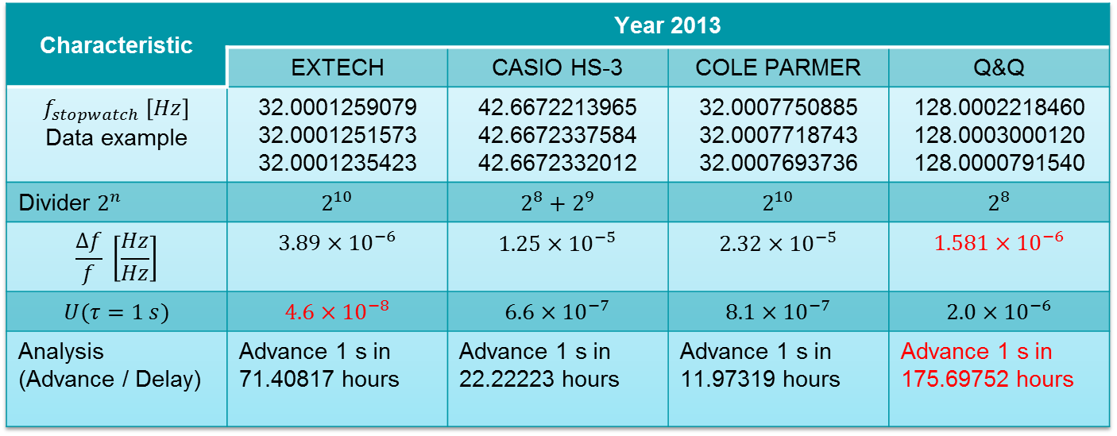
INDIRECT FREQUENCY MEASUREMENT
Characteristic | Year 2013
 | EXTECH | CASIO HS-3 | COLE PARMER | Q&Q
$$f_{stopwatch} \left[Hz\right]$$ Data example | 32.0001259079 32.0001251573 32.0001235423 | 42.6672213965 42.6672337584 42.6672332012 | 32.0007750885 32.0007718743 32.0007693736 | 128.0002218460 128.0003000120 128.0000791540
Divider $2^{n}$ | $$2^{10}$$ | $$2^{8}+2^{9}$$ | $$2^{10}$$ | $$2^{8}$$
$$\frac{∆f}{f} \left[\frac{Hz}{Hz}\right]$$ | $$3.89×{10}^{−6}$$ | $$1.25×{10}^{−5}$$ | $$2.32×{10}^{−5}$$ | $$1.581×{10}^{−6}$$
$$U(τ=1 s)$$ | $$4.6×{10}^{−8}$$ | $$6.6×{10}^{−7}$$ | $$8.1×{10}^{−7}$$ | $$2.0×{10}^{−6}$$
Analysis (Advance / Delay) | Advance 1 s in 71.40817 hours | Advance 1 s in 22.22223 hours | Advance 1 s in 11.97319 hours | Advance 1 s in 175.69752 hours

Slide 19
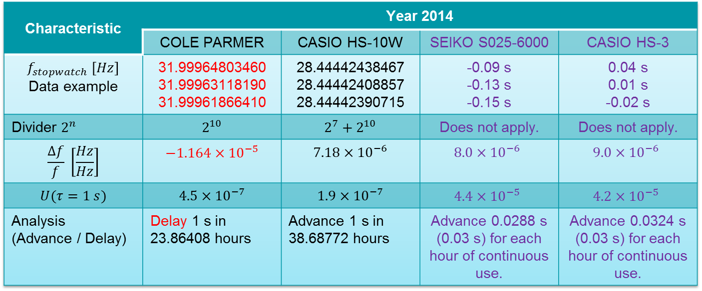
COMPARISON
Characteristic | Year 2014
 | COLE PARMER | CASIO HS-10W | SEIKO S025-6000 | CASIO HS-3
$$f_{stopwatch} \left[Hz\right]$$ Data example | 31.99964803460 31.99963118190 31.99961866410 | 28.44442438467 28.44442408857 28.44442390715 | -0.09 s -0.13 s -0.15 s | 0.04 s 0.01 s -0.02 s
Divider $2^{n}$ | $$2^{10}$$ | $$2^{7}+2^{10}$$ | Does not apply. | Does not apply.
$$\frac{∆f}{f} \left[\frac{Hz}{Hz}\right]$$ | $$−1.164×{10}^{−5}$$ | $$7.18×{10}^{−6}$$ | $$8.0×{10}^{−6}$$ | $$9.0×{10}^{−6}$$
$$U(τ=1 s)$$ | $$4.5×{10}^{−7}$$ | $$1.9×{10}^{−7}$$ | $$4.4×{10}^{−5}$$ | $$4.2×{10}^{−5}$$
Analysis (Advance / Delay) | Delay 1 s in 23.86408 hours | Advance 1 s in 38.68772 hours | Advance 0.0288 s (0.03 s) for each hour of continuous use. | Advance 0.0324 s (0.03 s) for each hour of continuous use.

Slide 20

¡Gracias!
Thank you!
Obrigado!
http://aprendelenguadesignos.com/signos-de-gracias-y-hola/

